Slide 1
The Big Questions
What do these things have in common
Henry Ford
Ute Indians
Corrupt Congress
Chewing Gum
Mailing Bricks
Fracking

Slide 2
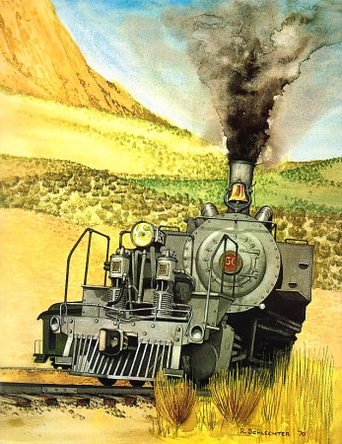
Robert Schlecter Painting.
The Uintah Railway -
The Gilsonite Route or the Little Railway the could.

Slide 3
Where we are going
History
Route
Mines
Motive Power
Bricks
Now

Slide 4
History
Early history
Sam Gibson & Bert Seaboldt
$25,000.00 to congress 1888-9
Being used for varnish, paint pigment, insulating wire and lubricants and chewing gum aditive.

Slide 5
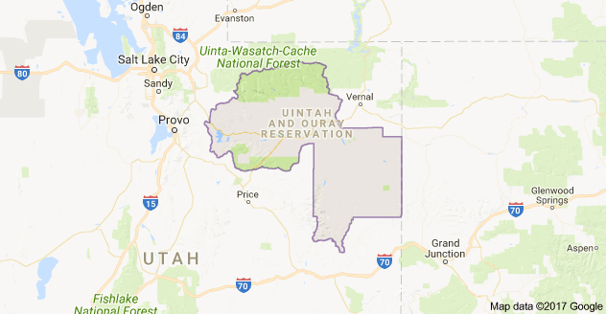

Slide 6
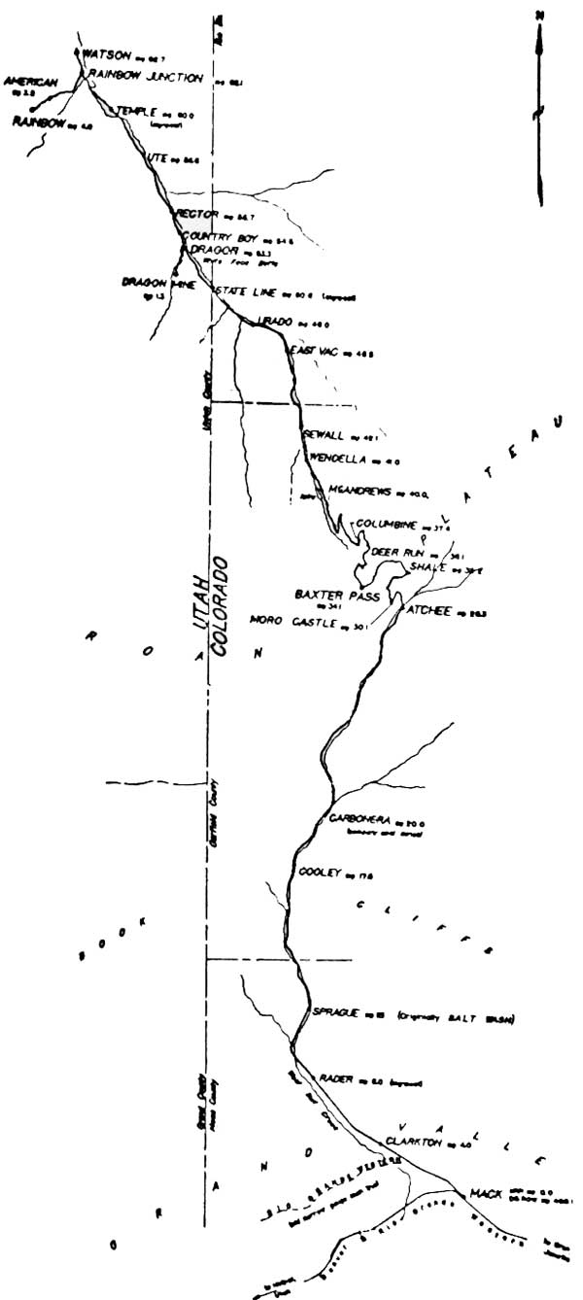
Route
Map Courtesy of the BLM

Slide 7
Route
From Mack Colorado to Dragon Utah 53 miles
From Mack to Atchee 28.6 miles, 36 bridges
From Atchee over Baxter Pass 2,000 ft in 6 miles
First mile 5%
7.5% to top of pass, at 8,737 feet
Pass down 5% for 7 miles, 1,500 drop in elevation
Sharpest curve 80% later reduced to 66% in 1926
Curves ranged from 30 to 50% with more than 27 exceeding 27%
Total 13 miles, 233 curves, 3,500 elevation change
Next 12 miles to Dragon 37 more bridges.

Slide 8
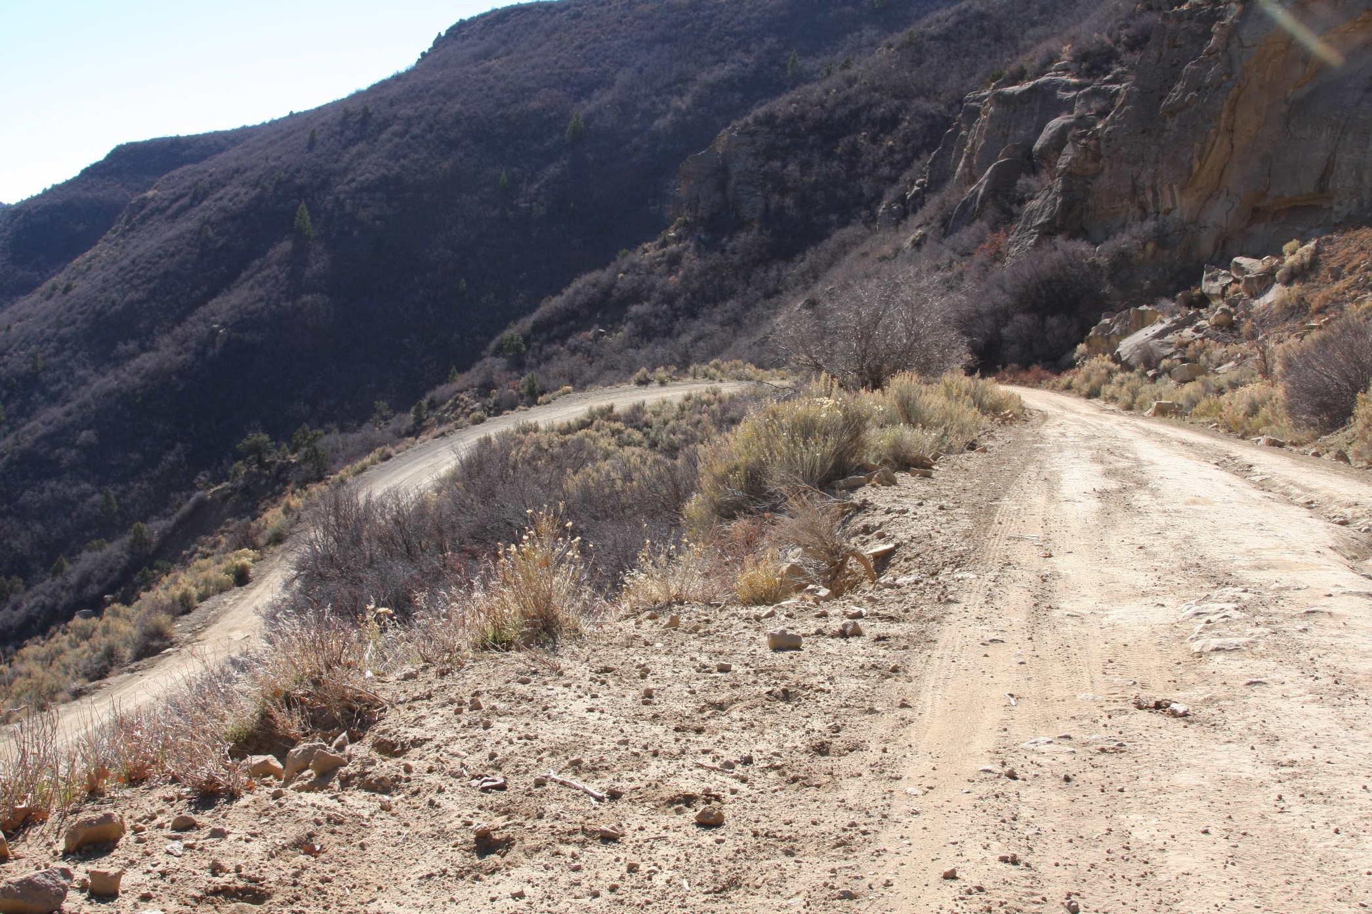
DGRW.net Atchee-Baxter Pass

Slide 9
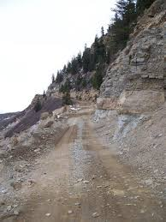
The Same area of Baxter Pass as it would have looked to the Engineer, Conductor and
Passengers!

Slide 10
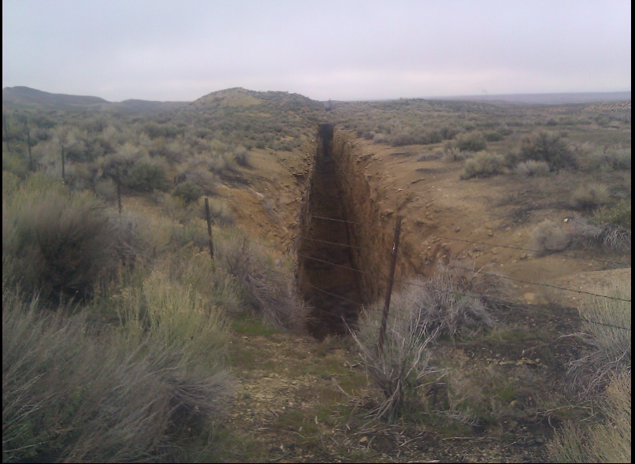
Mines
Copyright – Rockpick Legend Co. & Rick Dalrymple

Slide 11
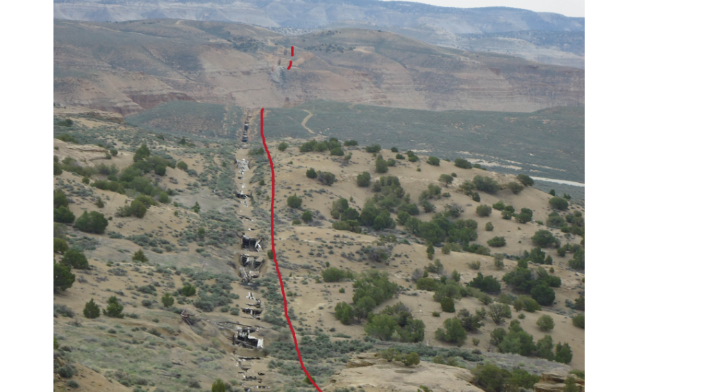
Copyright – Rockpick Legend Co. & Rick Dalrymple

Slide 12
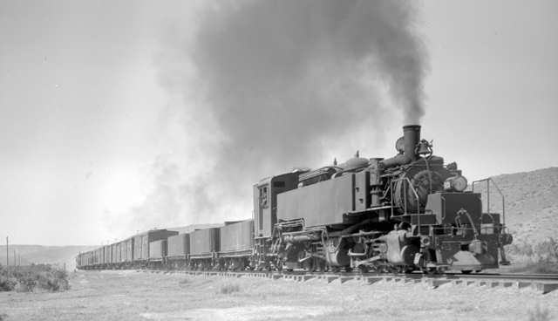
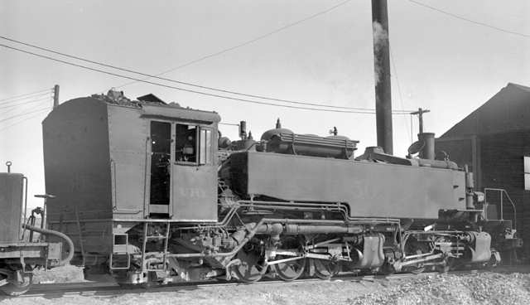
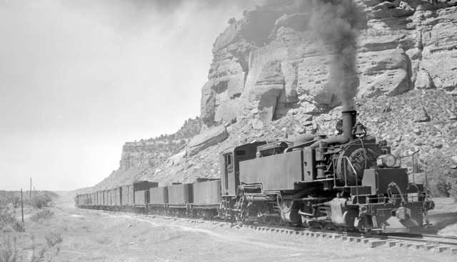
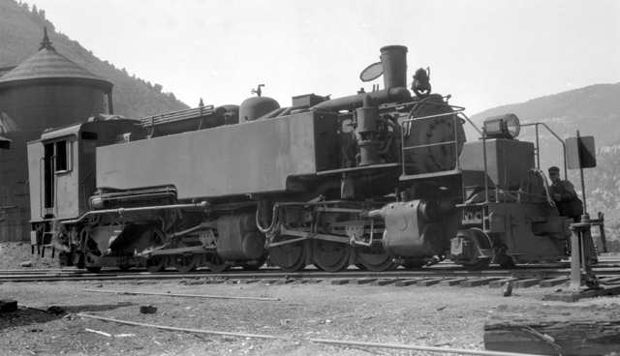
Motive Power

Slide 13
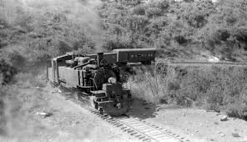
Narrow Gauge Discussion Forum

Slide 14
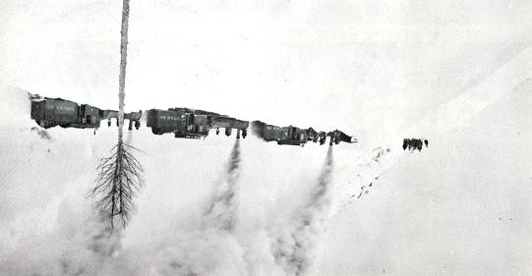

Slide 15
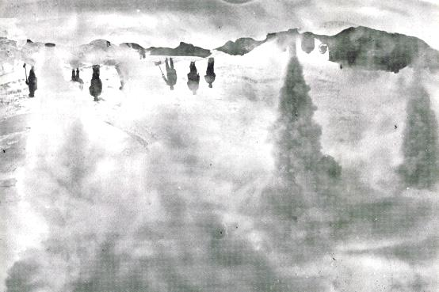

Slide 16
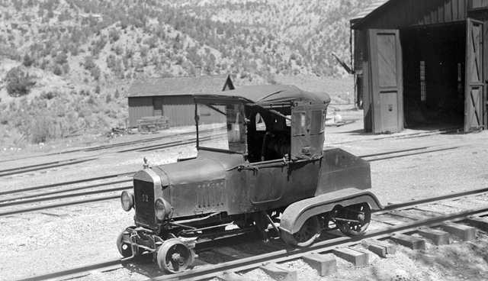

Slide 17
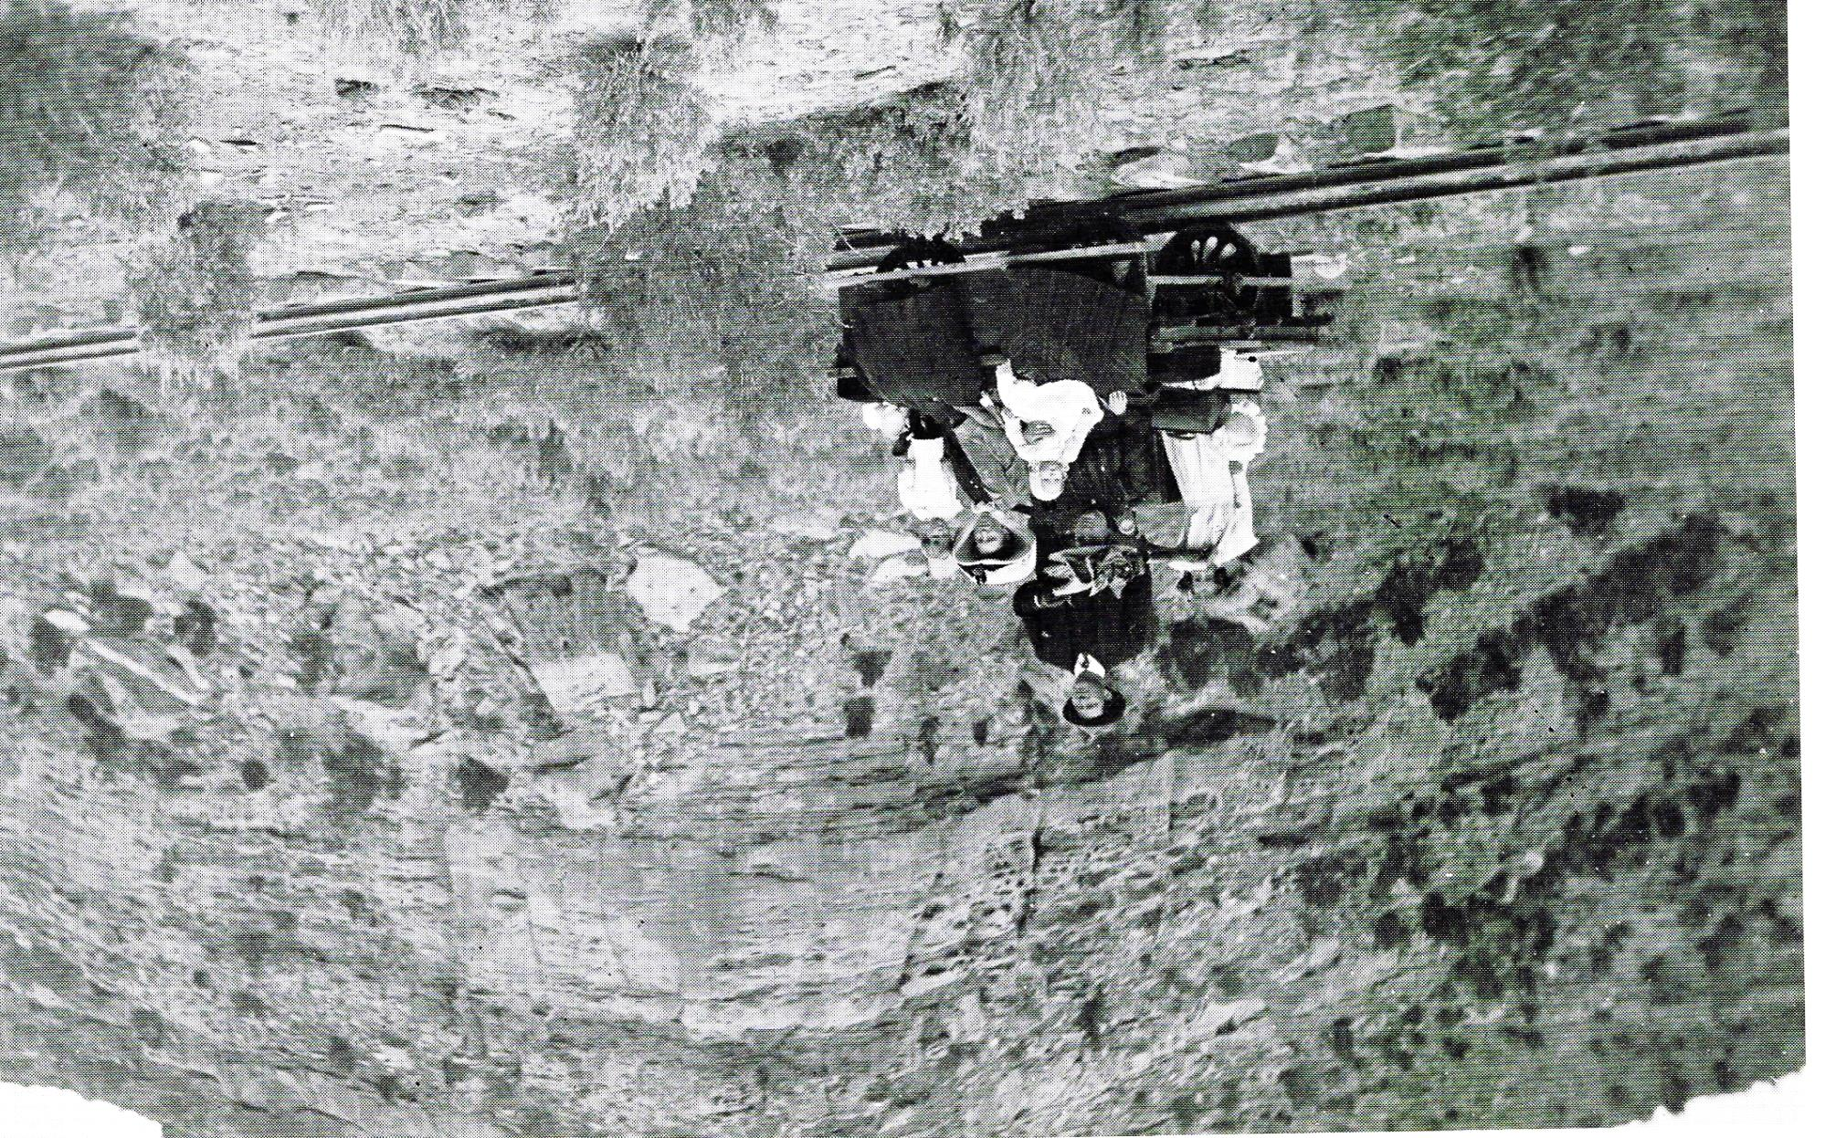

Slide 18
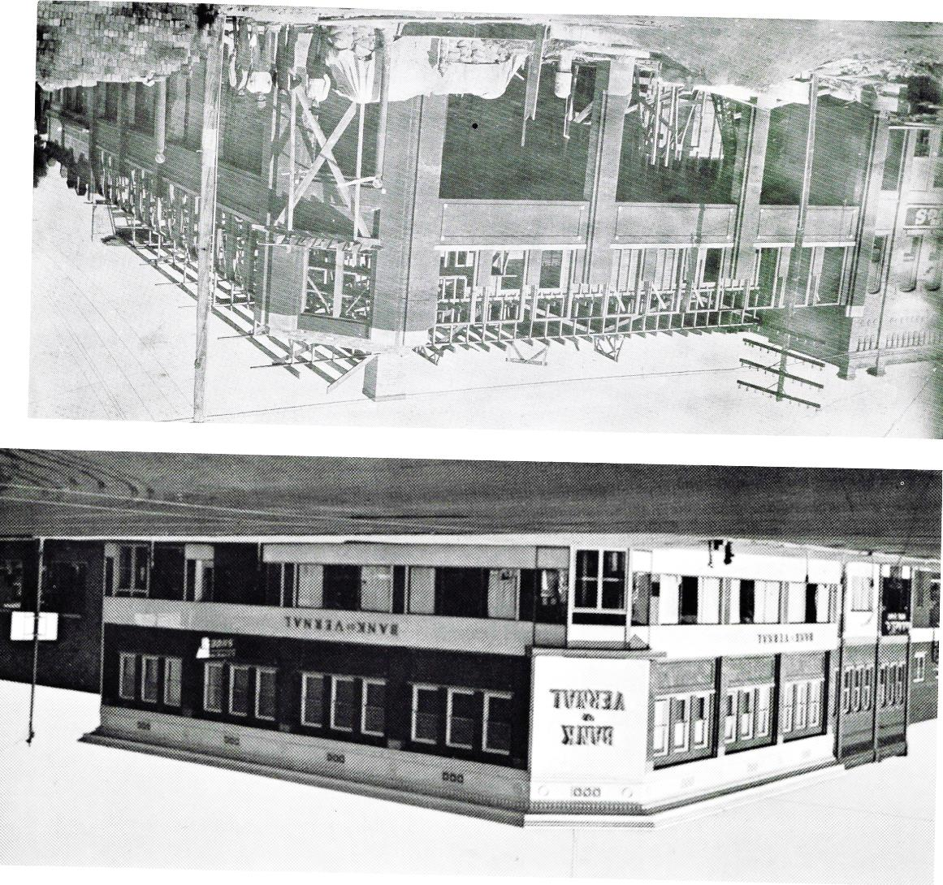
Mailing Bricks

Slide 19
Now
Many owners over the years
Standard Oil and others
Currently called - American Gilsonite Company
Drilling mud and Fracking supplies
In and out of Chapter 11

